Slide 1
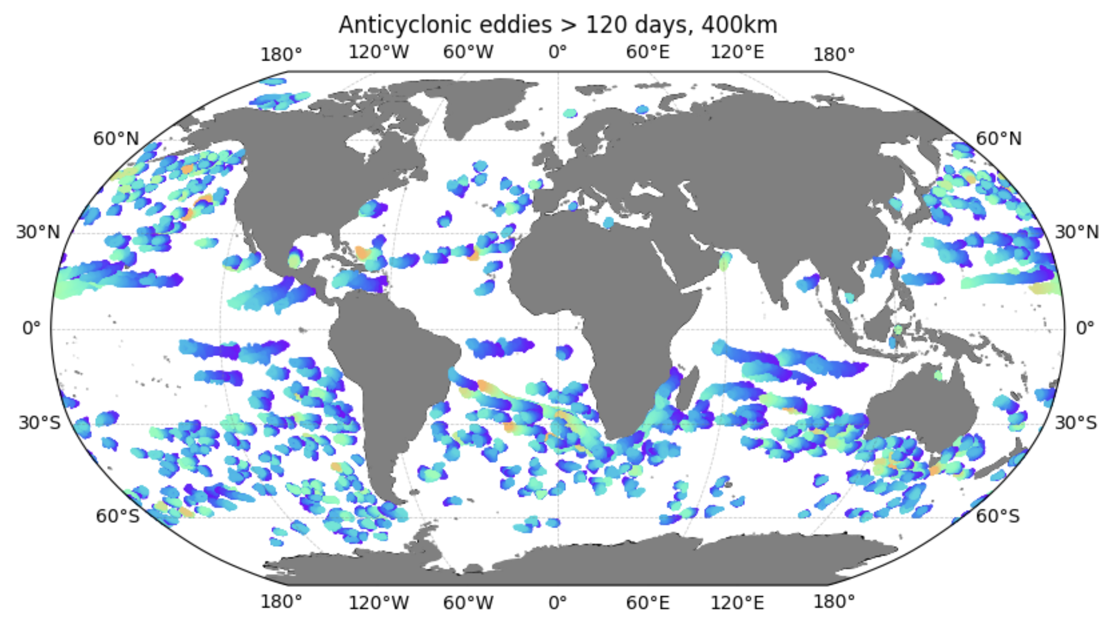
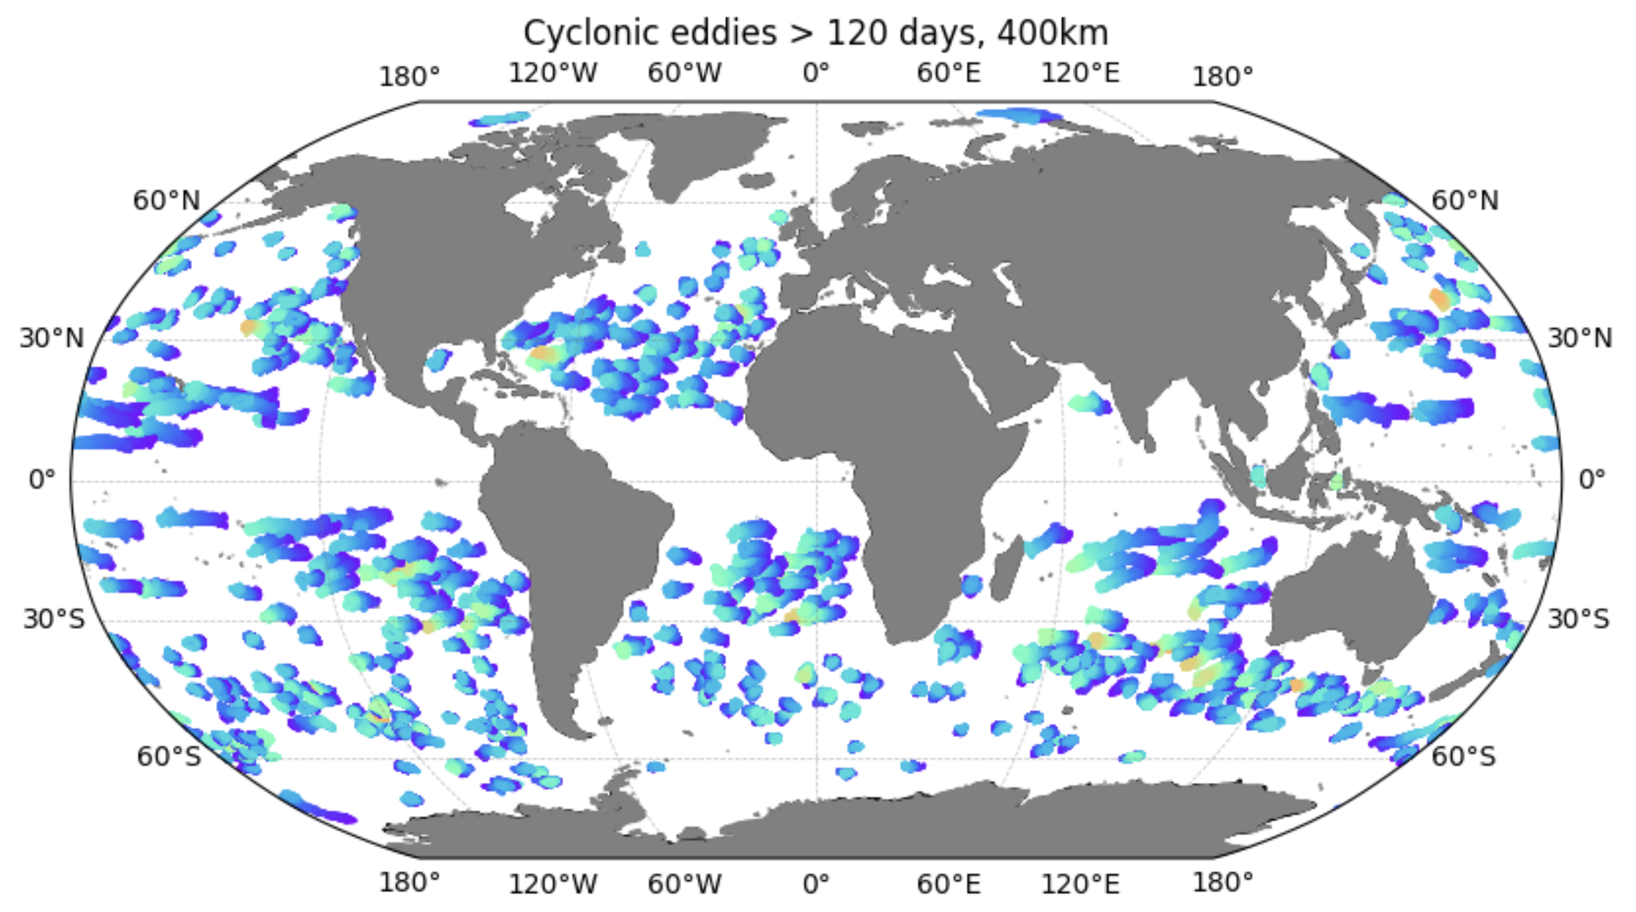
Impact of mesoscale eddies on the ocean biogeochemistry
– primary analysis of the 5-km ICON-HAMOCC coupled simulation for 2020
Anticyclonic
Cyclonic
Long-lived mesoscale eddies lasting longer than 120 days
High pass filtered with a wavelength of 400km; tested also with 700km (used in the obs case), giving more eddy detections.

Slide 2
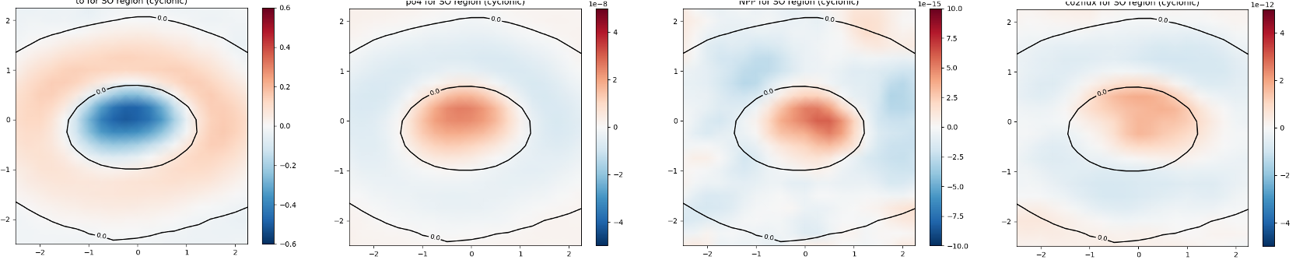
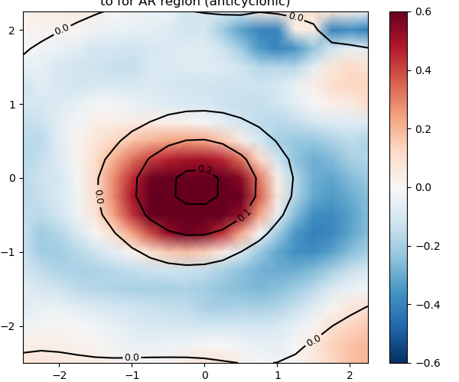
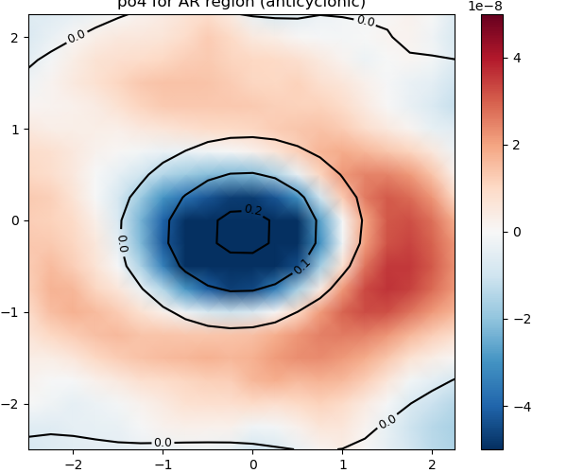
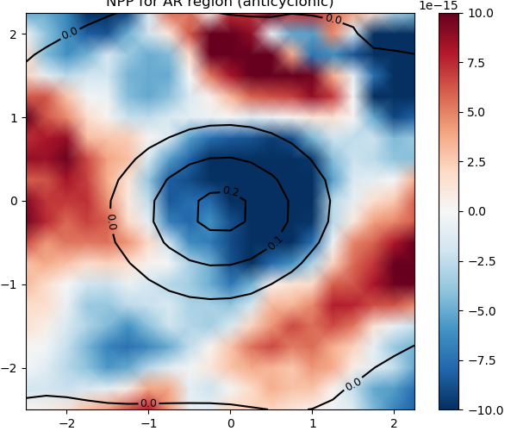
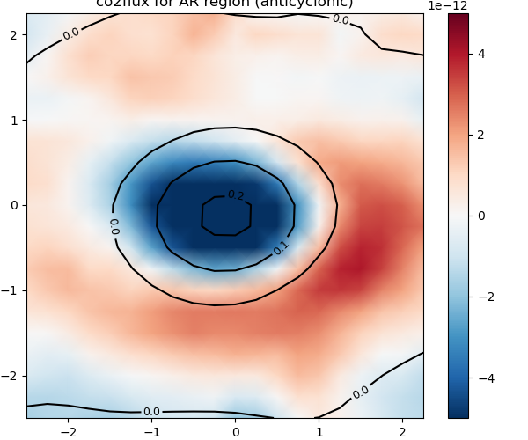
Southern Ocean cyclones
Net air-sea CO2 flux (kmol C m-2 s-1)
SST (ºC)
PO4 (kmolP m-3)
NPP (kmolP m-3 s-1)
b
c
d
Less uptake
a
More uptake
Generally, in cyclonic eddies, upwelling brings colder, nutrient water to the surface (Fig a, b). The increased nutrient availability enhances phytoplankton growth (Fig c). The positive CO2 flux anomaly is likely dominated by the upwelling of carbon-rich water (Fig d).
Agulhas anticyclones
Less uptake
e
f
g
h
More uptake
Agulhas rings show similar behaviour as the SO anticyclonic eddies, but with strong magnitudes of the response.

Slide 3
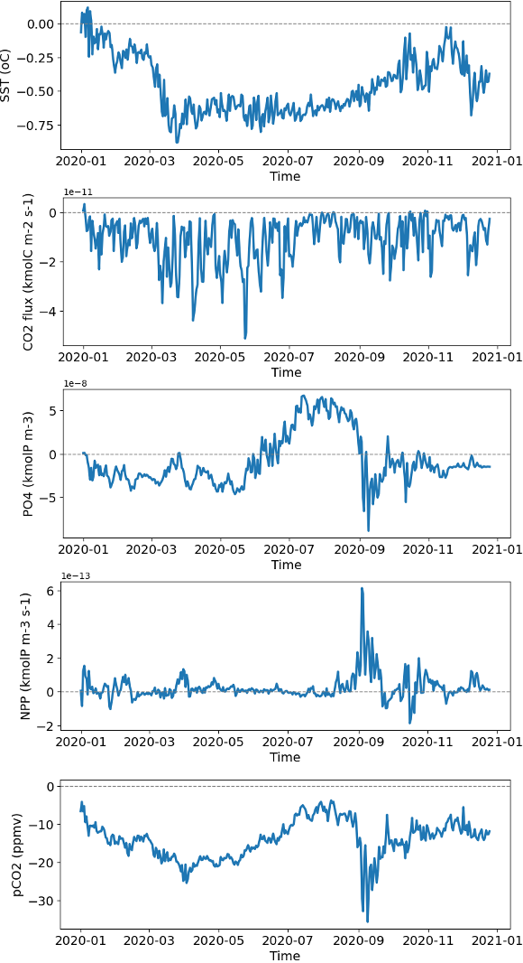
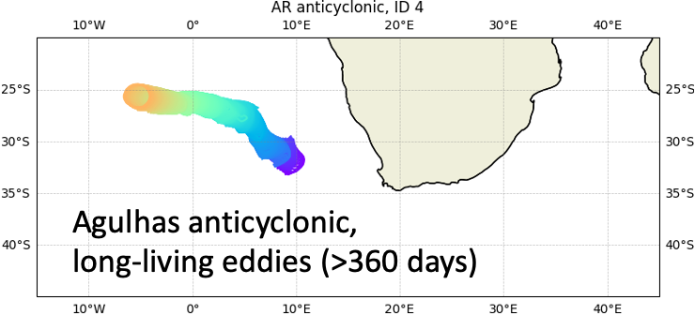
Possible mechanisms governing net CO2 flux anomalies differ among eddy tracks.
A cold core eddy, stronger solubility pump
Phytoplankton bloom, more CO2 uptake

Slide 4
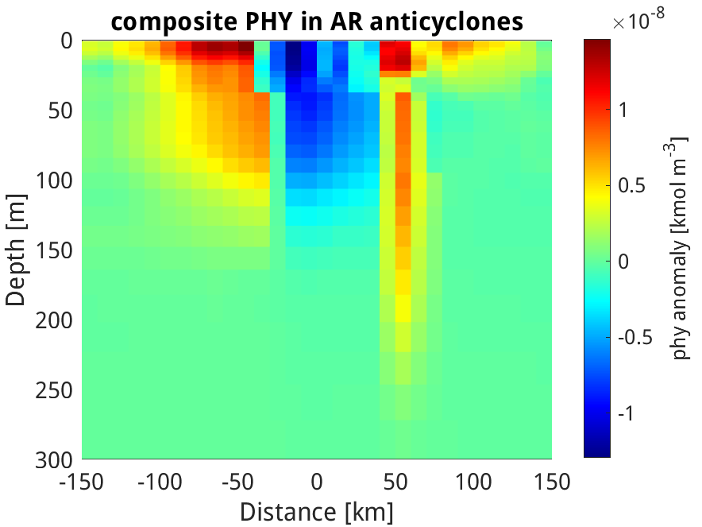
Planned analyses and experiments
Temporal and spatial (3D) structure of the eddy impact on ocean biogeochemical variables
Eddy's contribution to the budget terms of ocean biogeochemical variables (divergence of advective/diffusive fluxes, sources/sinks)
Cumulative impact of eddies on net CO2 flux
Decomposition of surface pCO2
Comparison with observations.
A longer run of >=10 years is needed for better eddy statistics.
Vertical structure in Agulhas Rings (anticyclones)

